Slide 1
Executive Summary
Key Points
Airlines have recovered quickly after major accidents
Airline industry revenue growth has been steady regardless of accidents
Airline industry usage growth has been steady regardless of accidents
Accidents occur less often for airlines than driving, mile for mile
Fatalities occur less often for airlines than driving, mile for mile
Airline travel imposes much less mortality risk than other uncommon causes of death

Slide 2
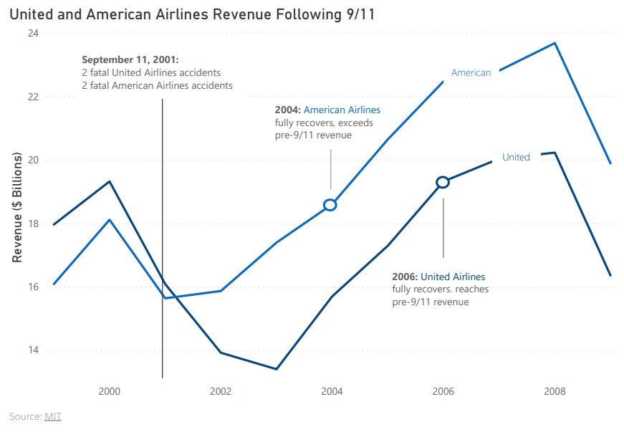
Specific Airlines Recover Quickly From Major Accidents

Slide 3
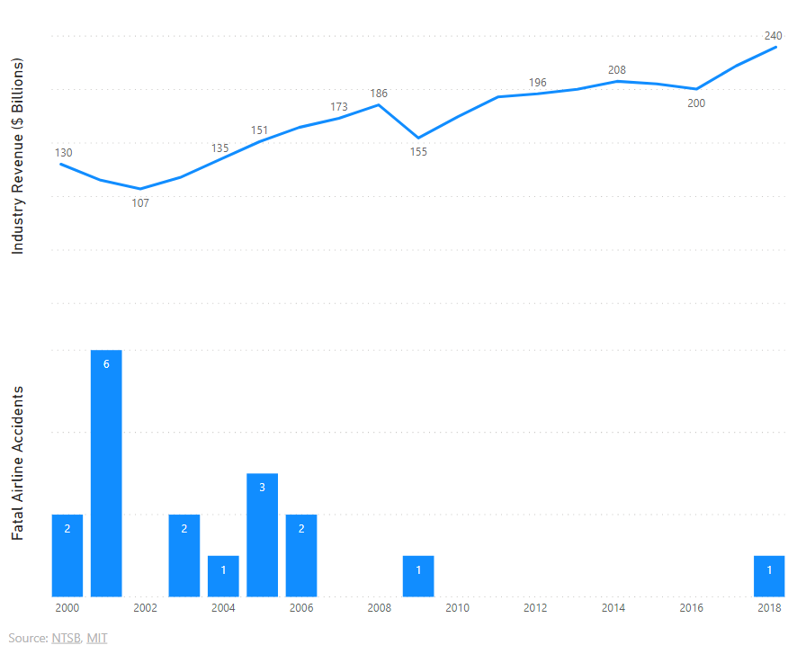
Airline Revenue Growth Has Been Steady Regardless of Fatal Accidents

Slide 4
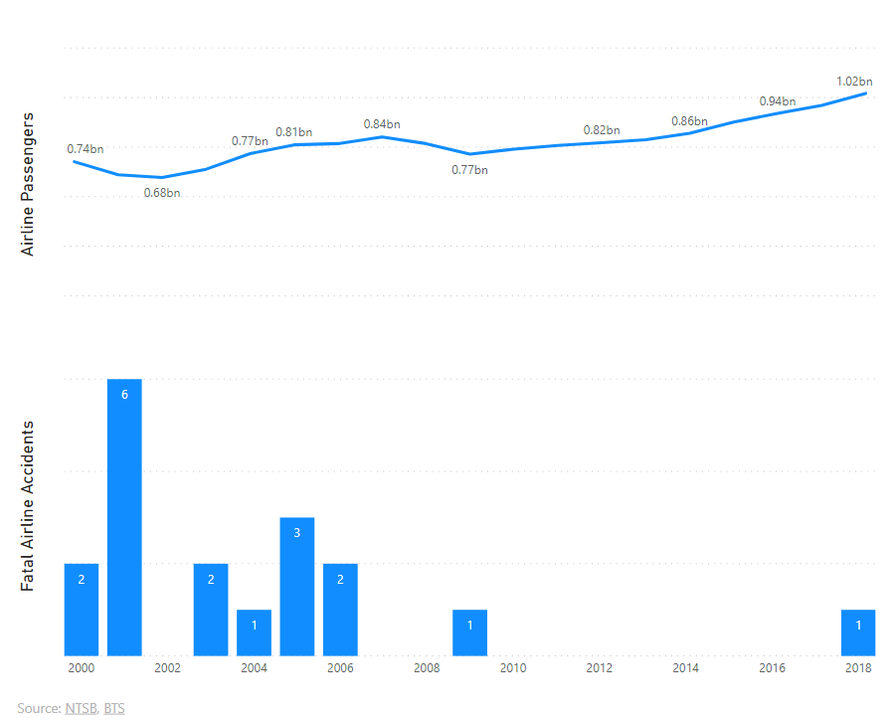
Airline Usage Has Continued to Grow After Fatal Accidents

Slide 5
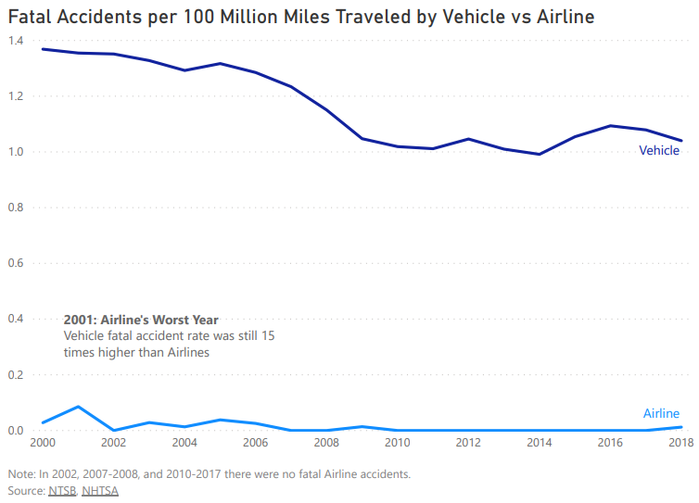
Airline Accidents Are Less Frequent Than Driving

Slide 6
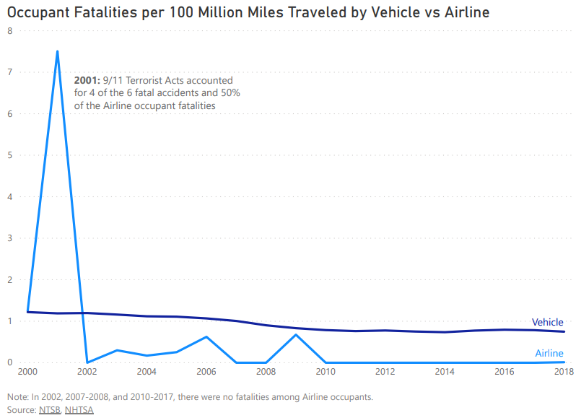
Airline Fatalities Are Less Frequent Than Driving

Slide 7
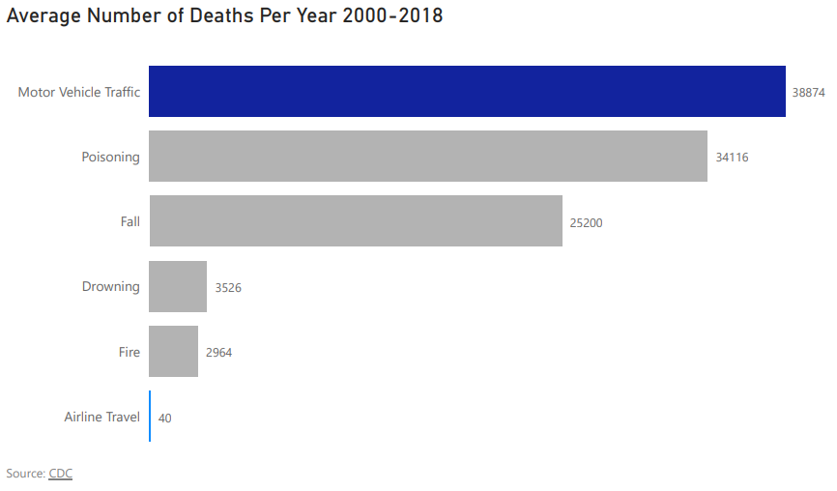
To Put Airline Travel Risk in Perspective

